Slide 1

Intensive Course Biology for Technology Department of Agricultural Technology Faculty of Technology, University of Colombo by Dr. Aruna Kumara Udawasala

Slide 2
Kingdom Animalia
Eukaryotic, multicellular organisms with cells organized into distinct tissues.
Heterotrophic nutrition
Most exhibit significant capacity for locomotion.
Cells not surrounded by cell walls.
Includes sponges, sea anemones, snails, insects, sea stars, fish, reptiles, birds, and human beings.

Slide 3
Phylogentic Relationships of Animals

Slide 4
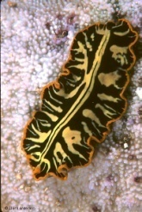
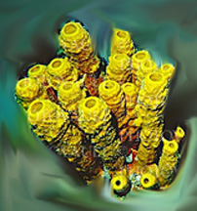
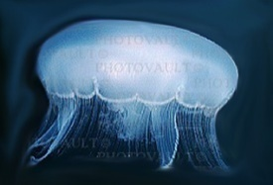

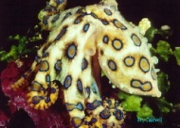
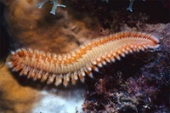
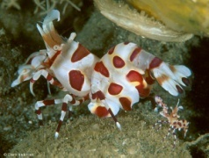
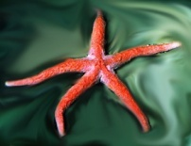
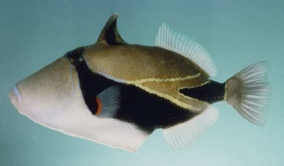
Phylogentic Relationships of Animals
Platyhelminthes
Porifera
Mollusca
Chordata
Arthropoda
Cnideria
Nematoda
Annelida
Echinodermata
pseudocoelom
segmentation
acoelom
Protostome: schizocoelem
Deuterostomes:
eucoelom
radial symmetry
bilateral symmetry
no true tissues
true tissue
Ancestral Protist

Slide 5
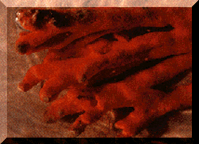
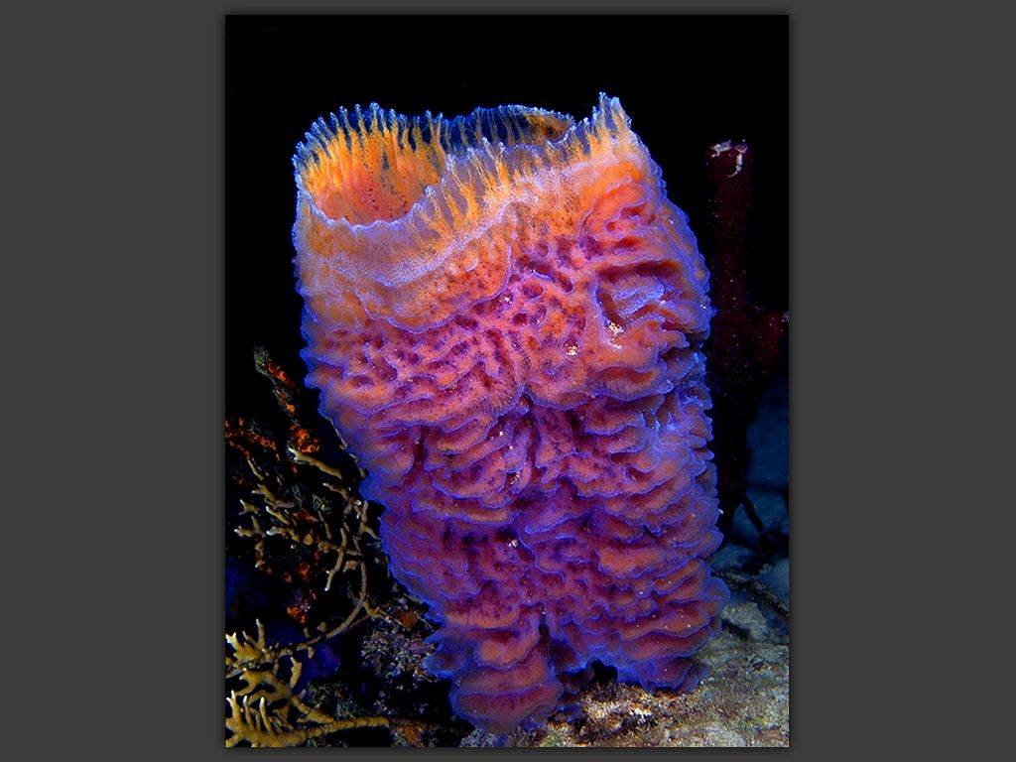
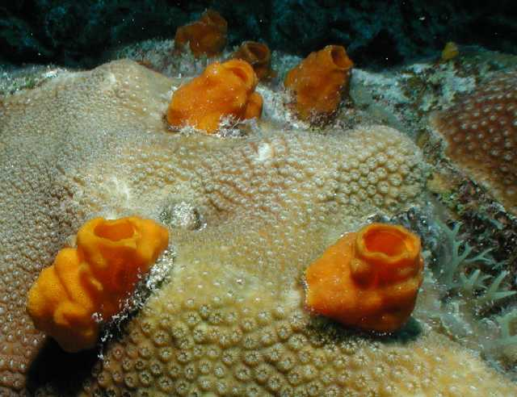
Kingdom Animalia
Phylum Porifera
Class Hexactinellida
Class Desmospongia
Class Calcaria
Purple and yellow
tube sponge
Boring sponge
Notes:
Phylum Porifera
Class Calcaria- calcium carbonate spicules
Hexactinelida- glass sponges found 450- 900m
Desmospongia-silicious spicules, 95% of all sponge species.
Most sponges are marine and are sessile as an adult. They are asymetrical- can’t be cut into equal halves.
Spicules: made up of CaCO3- gives support and is the main means of identification
Choanocyte (collar cells)- create currents that move water through the sponge. Food is engulfed and digested.
Amoebocyte (ameboid cells)- several types:
1. Distribute food captured and partially digested by collar cell to the remainder of the sponge.
2. Form gametes.
3. Secrete hard spicules.
Reproduction:
Asexual- reproduction by formation of buds; parental cells differentiate and grow outward from the parent forming a bud. These buds break off to become new individuals.
sexual- both hermaphroditic and dioecious species; usually produce eggs and sperm at different times.

Slide 6
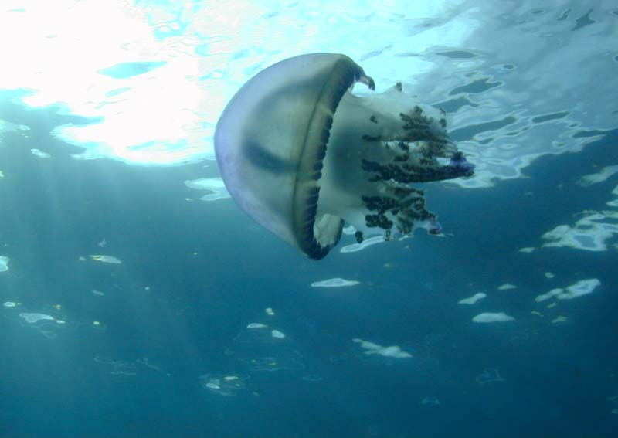
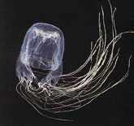
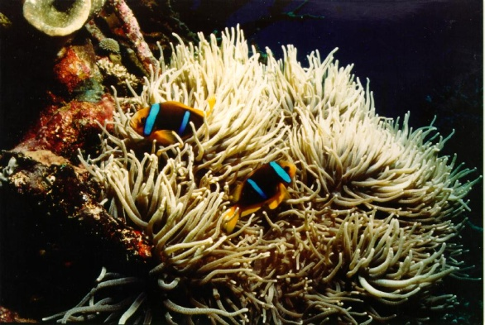
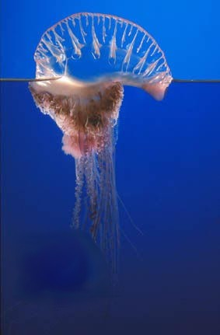
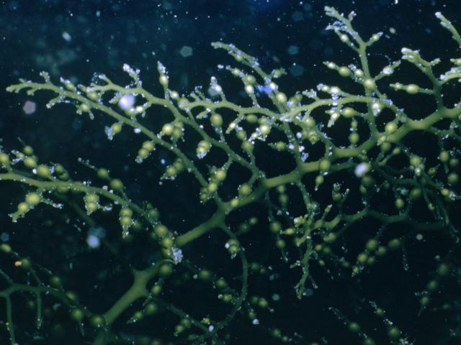
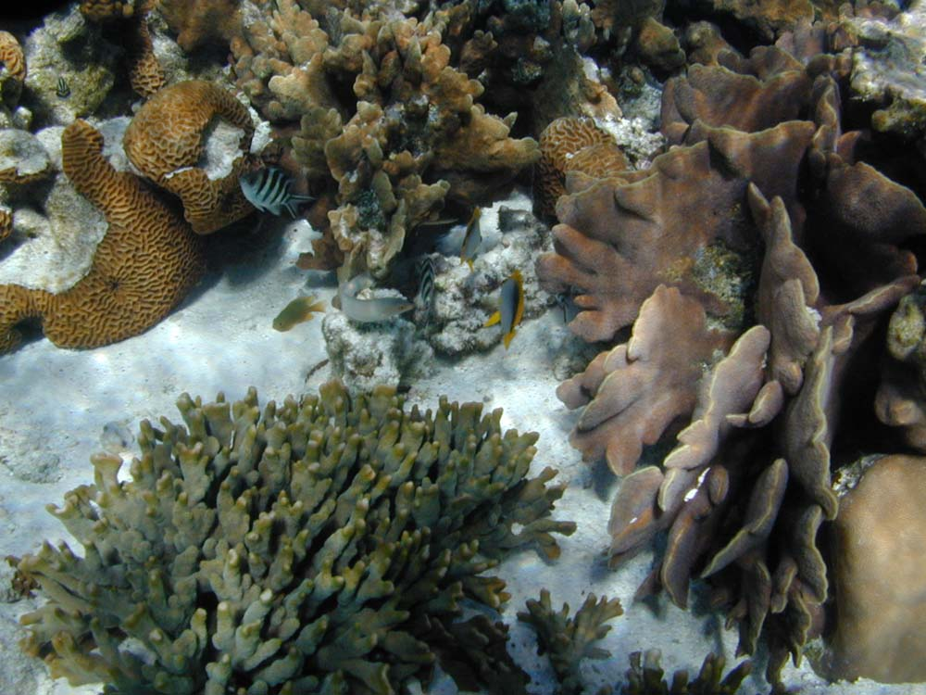
Kingdom Animalia
Phylum Cnideria
Class Hydrozoa- hydroids
Class Scyphozoa- jellies
Class Cubozoa- box jellies
Class Anthozoa- corals and anemones

Slide 7
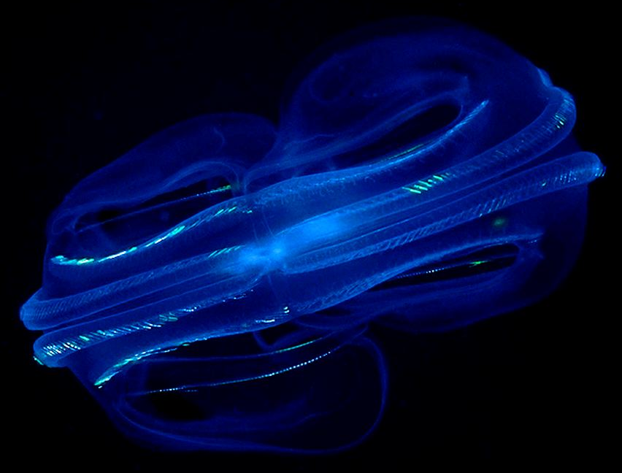
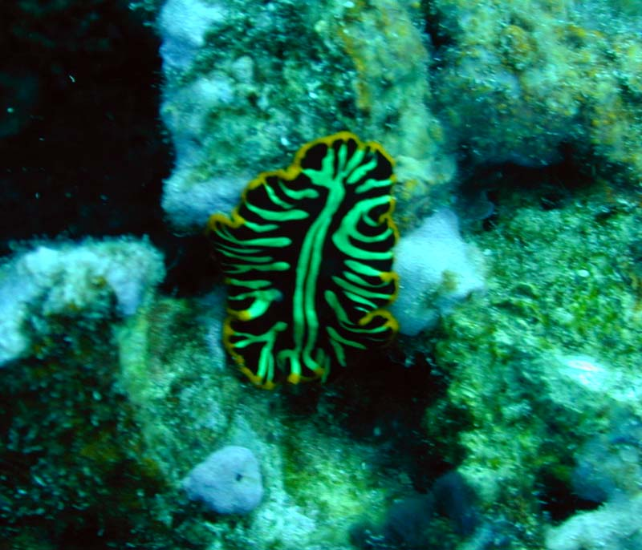
Kingdom Animalia
Phylum Ctenophora- comb jellies
Kingdom Animalia
Phylum Platyhelmithes- flat worms

Slide 8
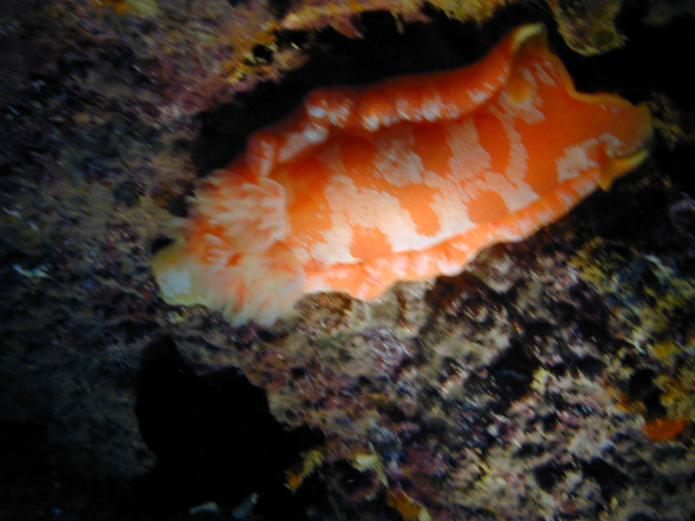
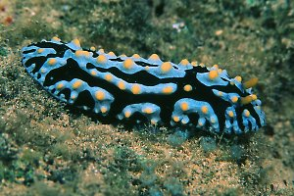
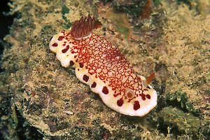
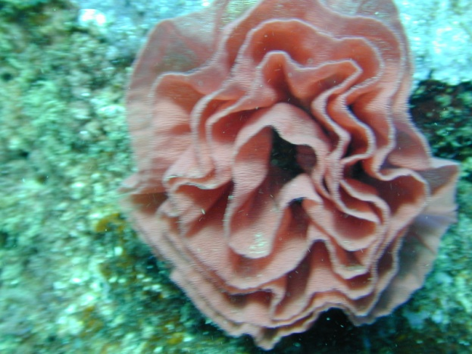
Kingdom Animalia
Phylum Mollusca
Class Gastropoda
Subclass Opisthobranchia
Spanish Dancer (nudibranch)
& egg mass

Slide 9
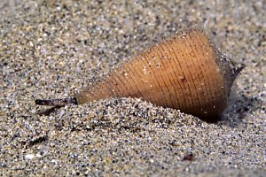
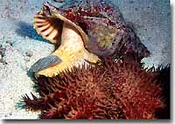
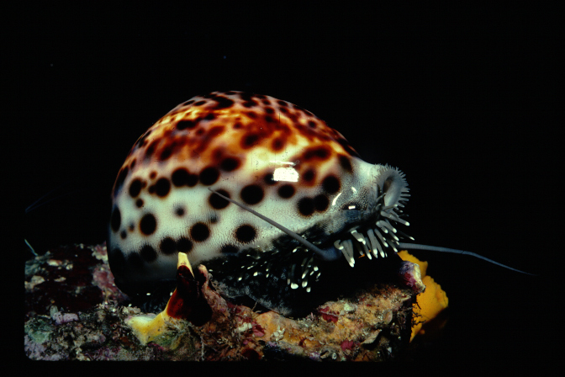
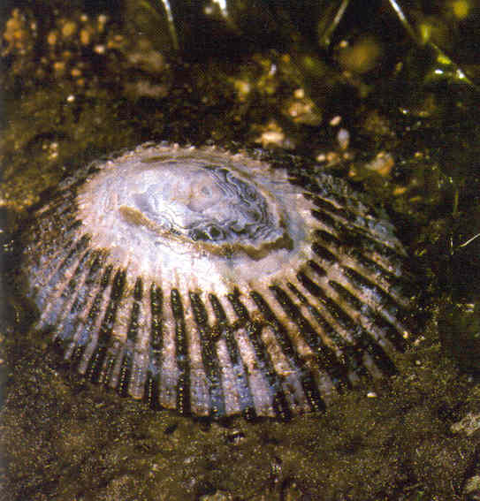
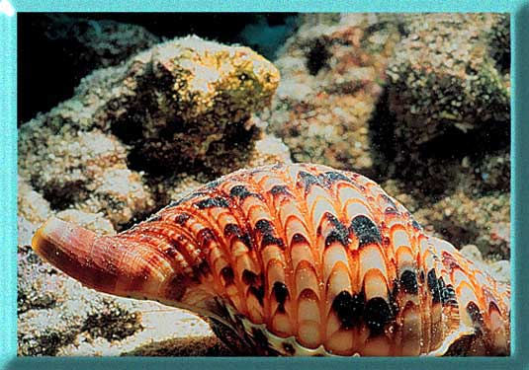
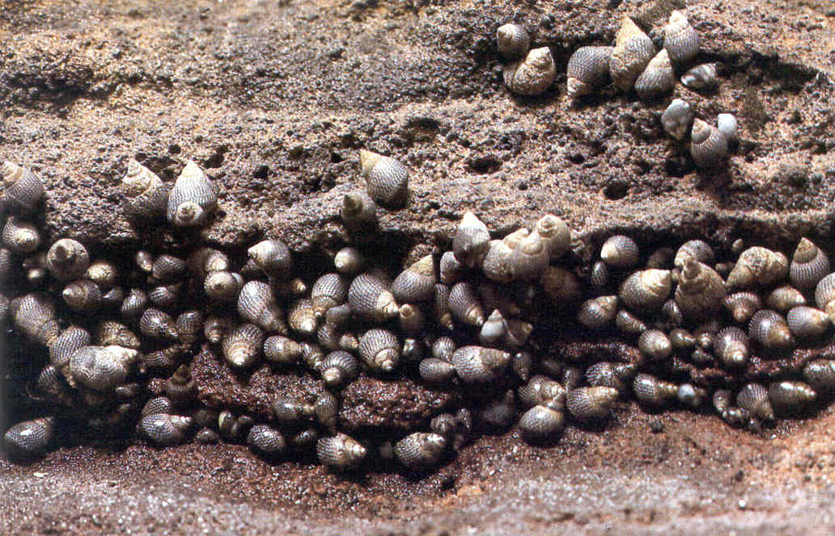
Class Gastropoda
Subclass Prosobranchia
Cone shell
Cowery
Opihi
periwinkle
Triton’s trumpet

Slide 10
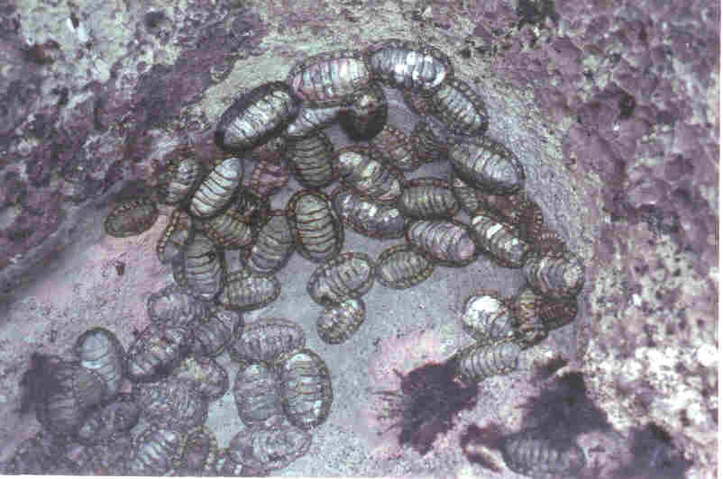
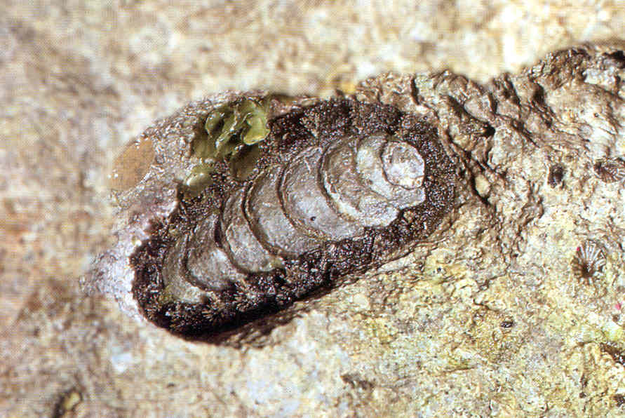
Class Polyplacophora (chitons)

Slide 11
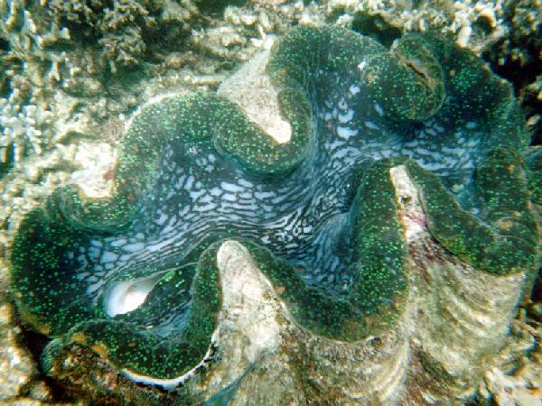
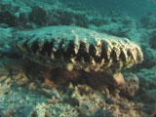
Class Bivalvia

Slide 12
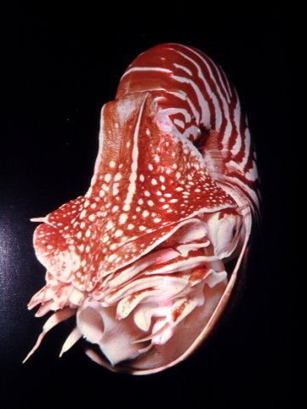
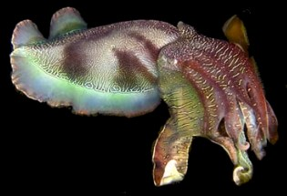
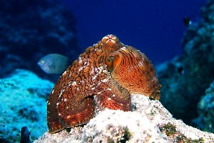
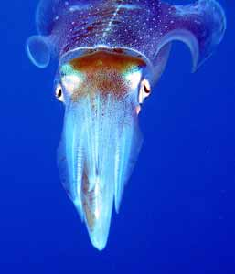
Class Cephalopoda
Day octopus

Slide 13
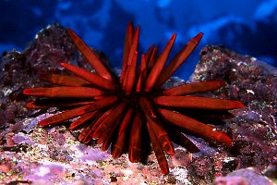
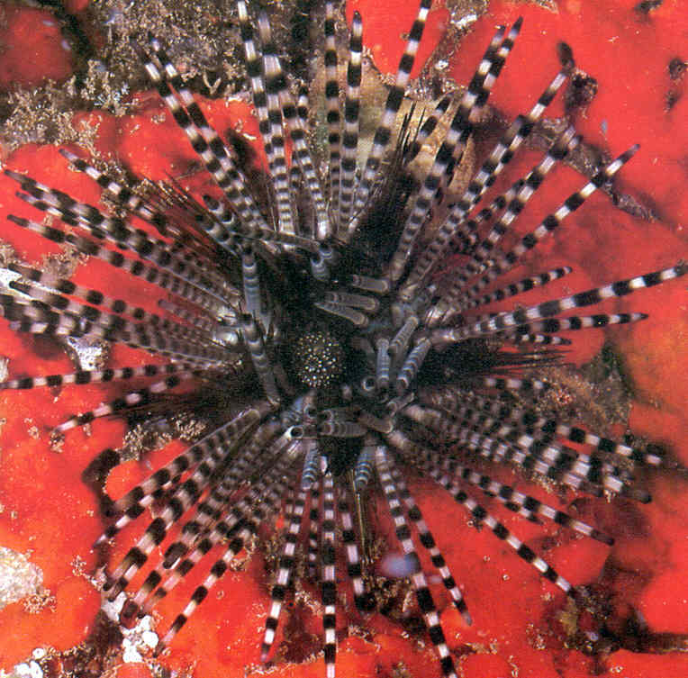
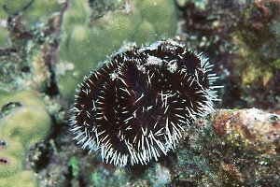
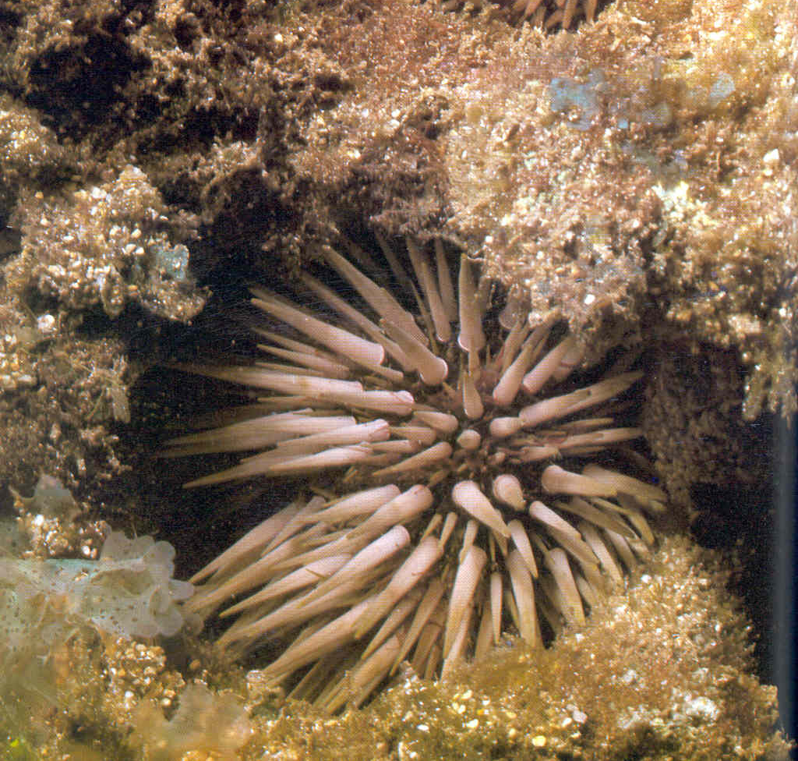
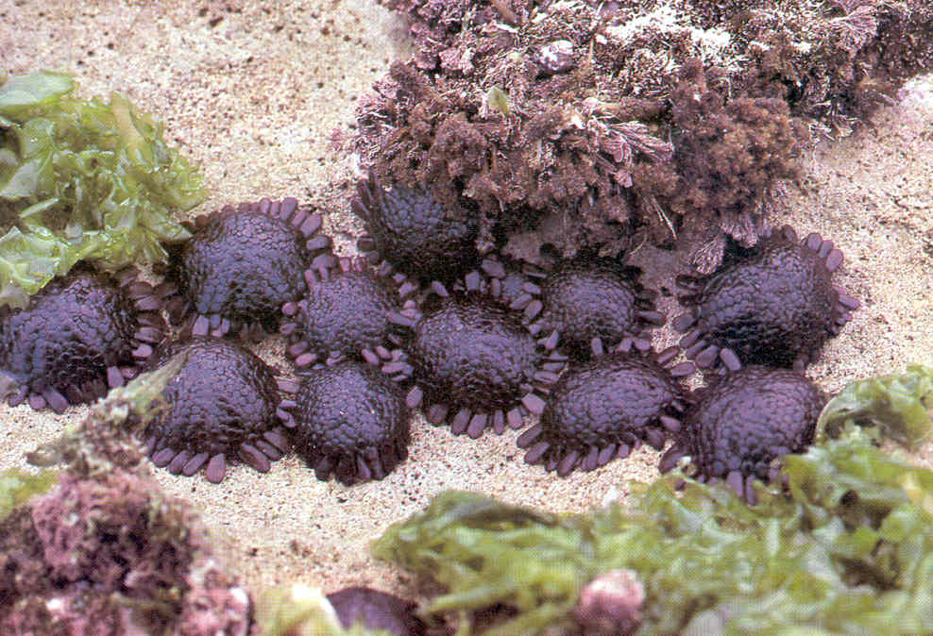
Phylum Echinodermata: Class Echinoidea: Sea Urchins
Slate pencil urchin
Collector urchin
Echinometra mathaei
Echinothrix calamaris
Colobocentrotus atratus

Slide 14
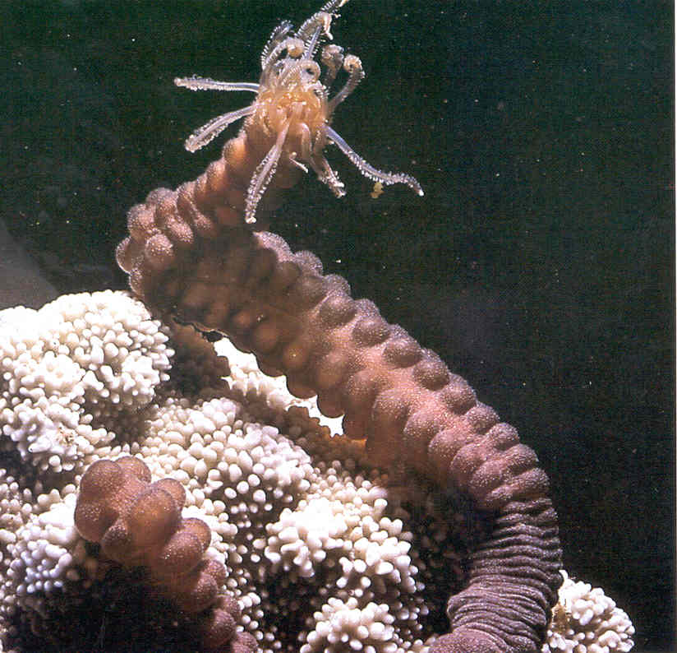
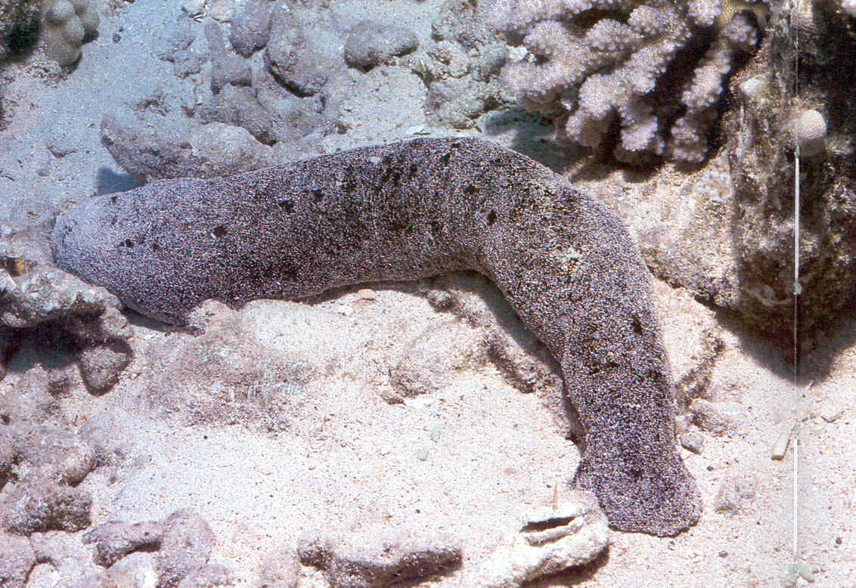
Class Holothuroidea: Sea Cucumbers
Polyplectana kerfersteninii
Holothuria atra

Slide 15
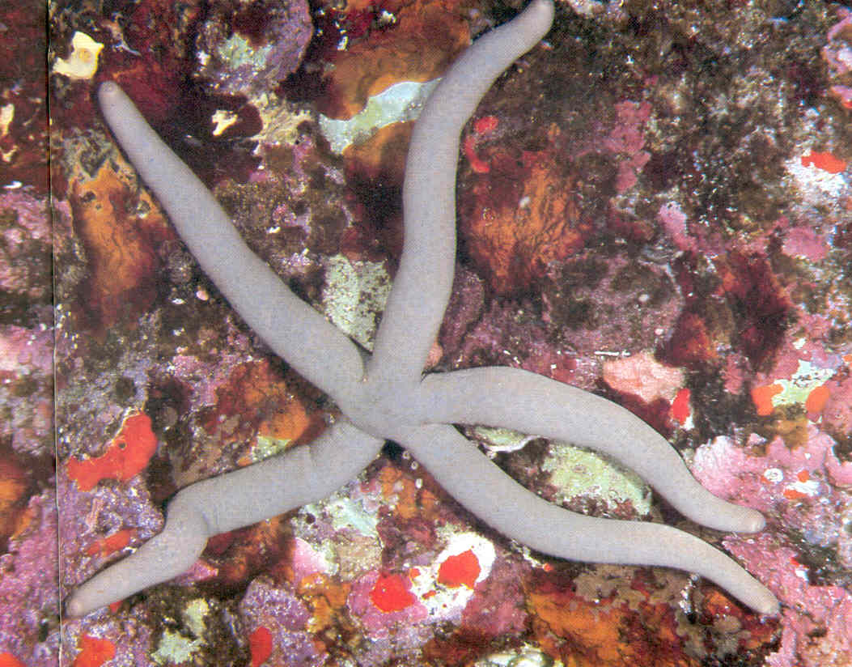
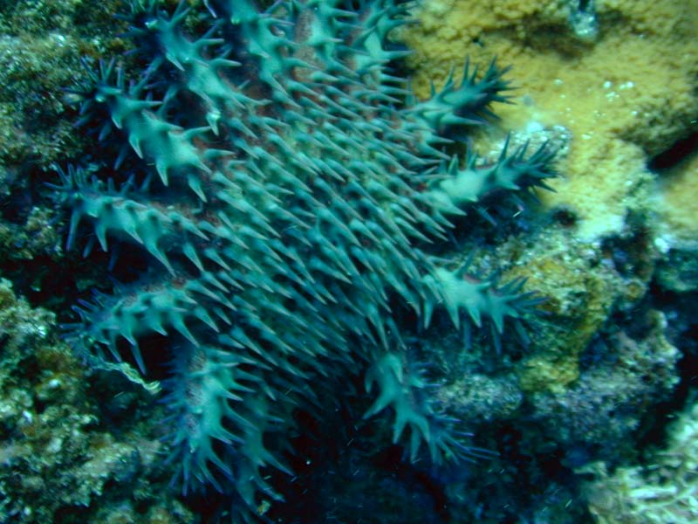
Class Asteroidea: Sea Stars
Linckia sp.
Acanthaster planci

Slide 16
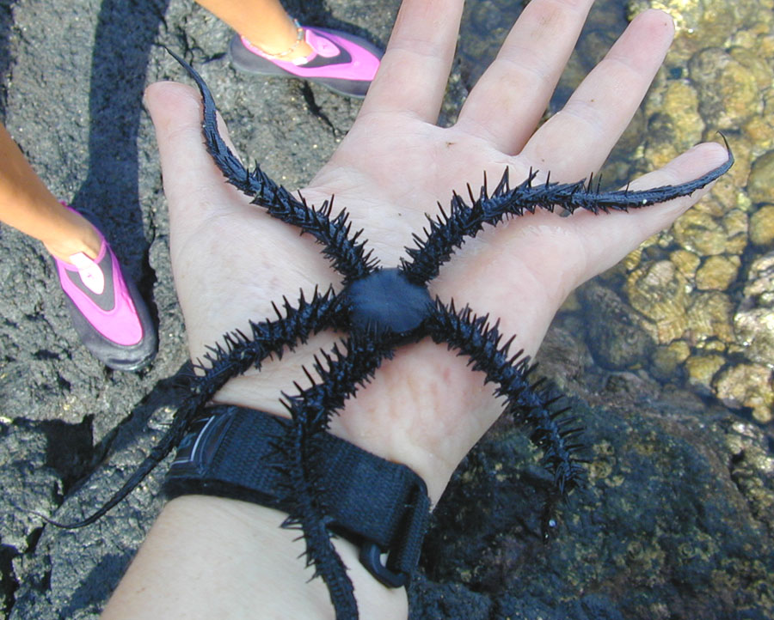
Class Ophiuroidea: Brittle Stars

Slide 17
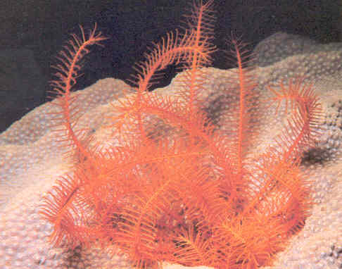
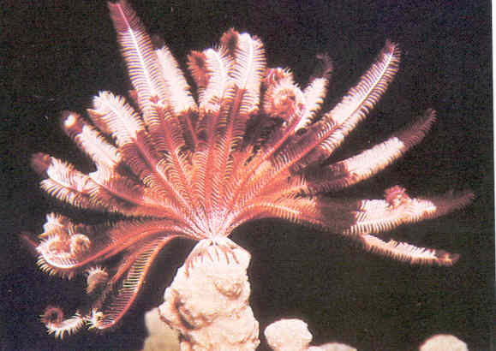
Echinodermata: Class Crinoidea: Feather Stars

Slide 18
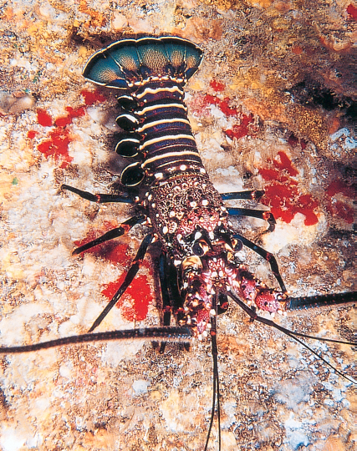




Phylum Arthropoda
Yellow spotted guard crab
Hawaiian cleaner shrimp
Spiny lobster
Anemone carrying hermit crab
Banded coral shrimp

Slide 19






Phylum Chordata
Subphylum Vertebrata
Class Chondrichthyes

Slide 20









Class Osteichthyes
680 species of fish in the islands' waters.
About 30% of these fish are endemic to the area .

Slide 21








Domino damsel
Trigger (Humu)
White mouthed
morey
Porcupine
Dwarf moray
Achilles tang
trumpetfish

Slide 22

Class Amphibia
Rana cancrivora

Slide 23




Class Reptilia
Saltwater crocodile
Marine iguana
Marine turtle
Sea snake

Slide 24




Class Aves

Slide 25






Class Mammalia
Whales & Dolphins
Polar bear
Sea otter
Seals & sealions
manatee
Dugong

Slide 26

Class Mammalia
Endothermic
4 chambered heart
Hair
Mammary glands
Internal fertilization
Live young (a few exceptions)
Care for young
Most intelligent class

Slide 27




Duck-billed platypus-monotreme
Killer whale (placental mammal)
Walrus (placental mammal)
Kangaroo (marsupial)

